Slide 1

App Development using Flutter SDK: Rental Room Finder
Laxman Chandrasali (201700491)
Adhyyan Tripathi (201700403)
Nikhil Sharma (201700523)
Under the guidance of
Mr. Dependra Dhakal
Assistant Professor

Slide 2
Table of Contents:
Abstract
Introduction
Literature Survey
Problem Definition
Solution Strategy
Gantt Chart
References

Slide 3
Introduction
This project is targeted towards the students who are willing to find rental rooms near the college.
This task get tough enough if the destination is remotely located.
The aim of this project is to give all the possible options regarding the room’s location and get the contact of respected person along with prices and images.

Slide 4
Introduction(Continue…)
Rental Rooms are great alternatives for hostelers as well as working employees.
This Flutter Application will help to find rooms in Android as well as IOS device.

Slide 5
Literature Survey
SL No. | Author details | Papers and Publication | Findings | Relevance
1. | Paulo Dinchin | www.bawp.com | Dart Language | Helped in the understanding of dart programming language
2. | Google | https://firebase.google.com/ | Real time database | Provided us with all the necessary documentation on the realtime -db.
3. | Google | https://flutter.dev/ | Flutter Framework | Provided us the flutter SDK.

Slide 6
Literature Survey
SL No. | Author details | Papers and Publication | Findings | Relevance
4. | Google | https://flutter.dev/docs | All the components and widgets which we have used in the project. | Provided us with all the necessary documentation on the widgets.
5. | Oyo | https://www.oyorooms.com/ | Search Mechanism | Helped in the search module implementation, by understanding the variables which needs to be considered.

Slide 7
Problem Definition
Students in SMIT find it very difficult to find Rental Rooms in vicinity
The process of finding and inquiring about the rooms and cost is very manual and time consuming.
Most of the rooms location are either not known to students or don’t have the motivation to roam around.

Slide 8
Solution Strategy
Our application will provide results of rooms around the vicinity of SMIT.
All the prices of the rooms will be displayed as well as the images of the rooms.
We will design our application for both android and iOS devices using Flutter.

Slide 9
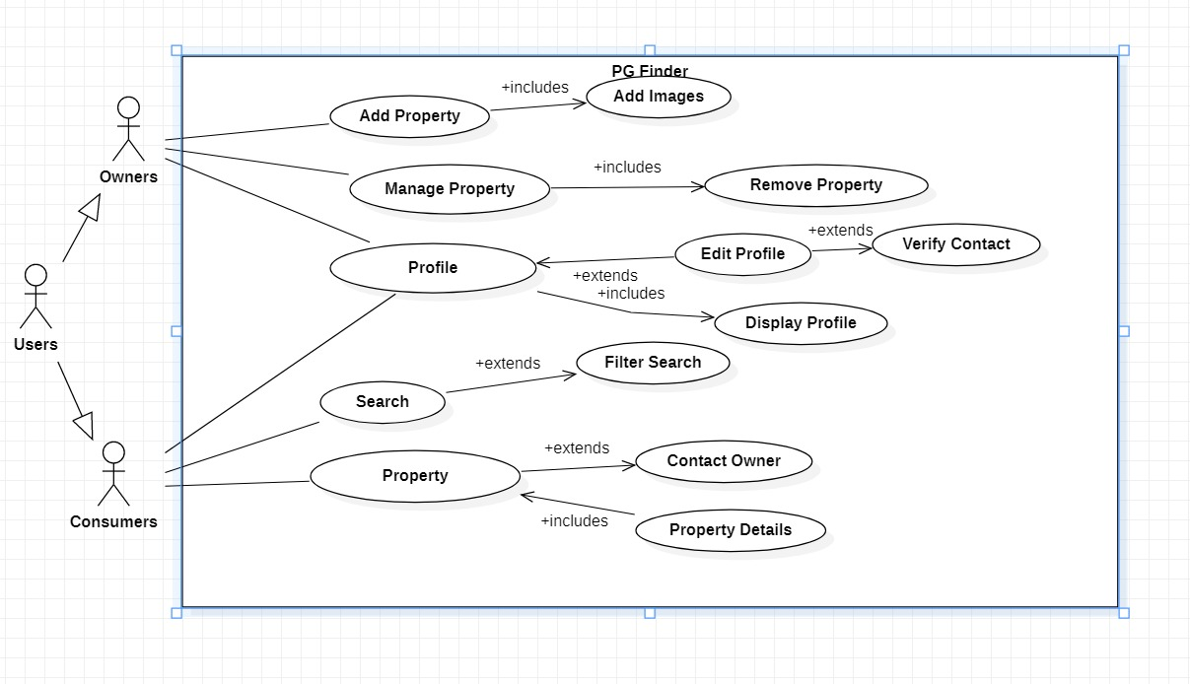
Use Case

Slide 10
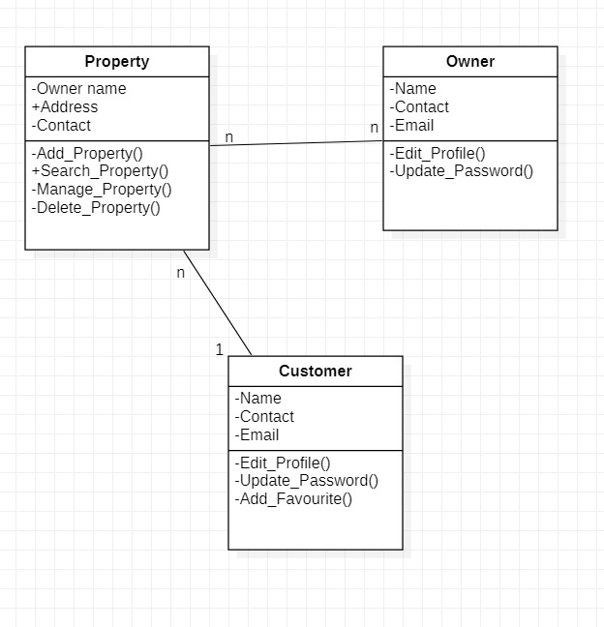
Class Diagram

Slide 11
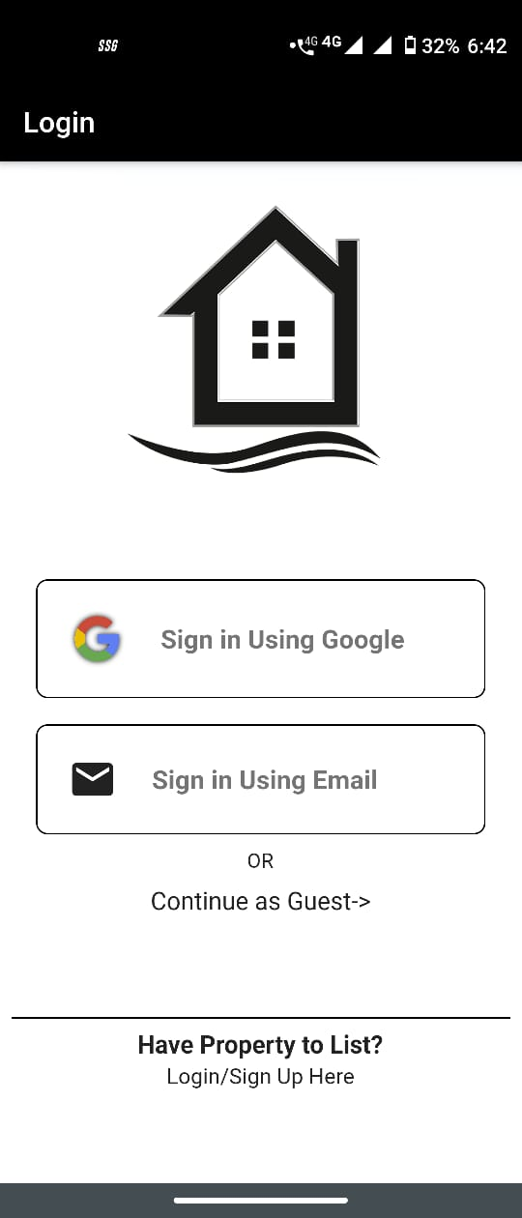
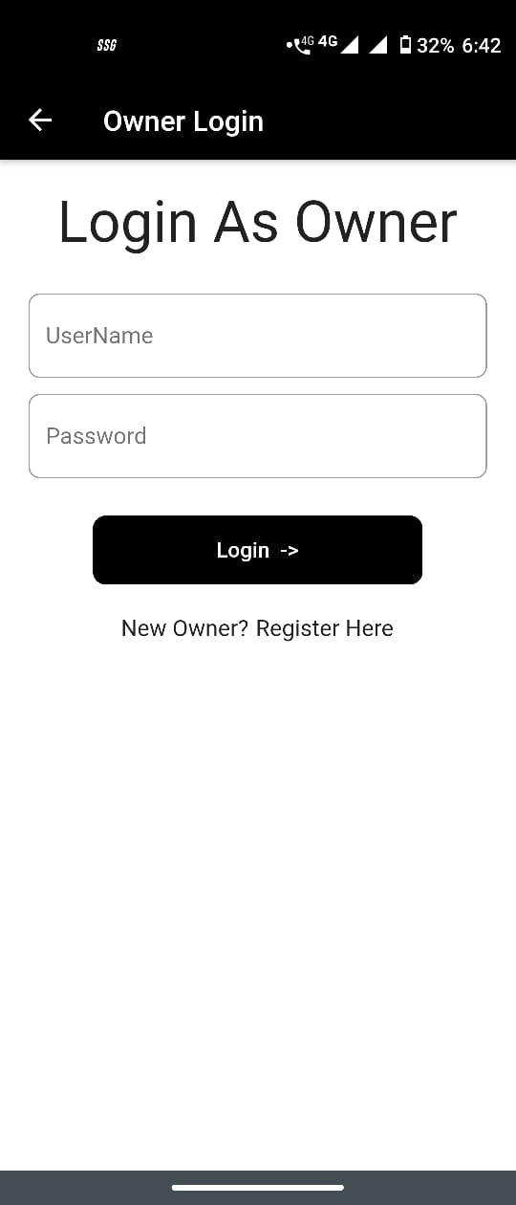
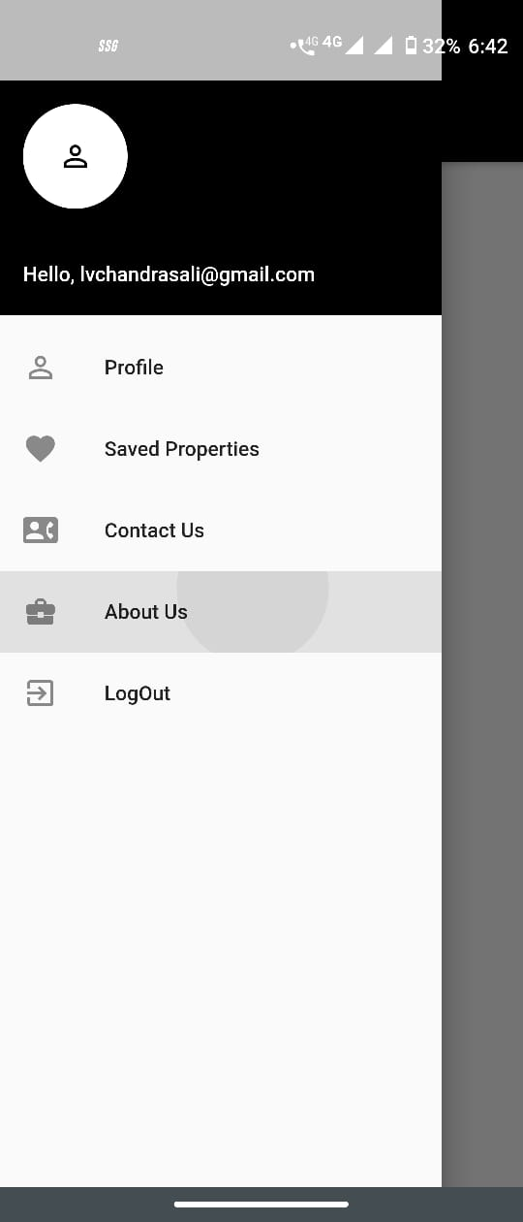
ScreenShots: Login

Slide 12
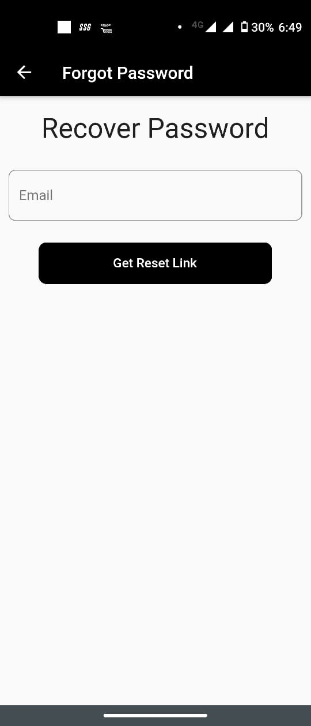
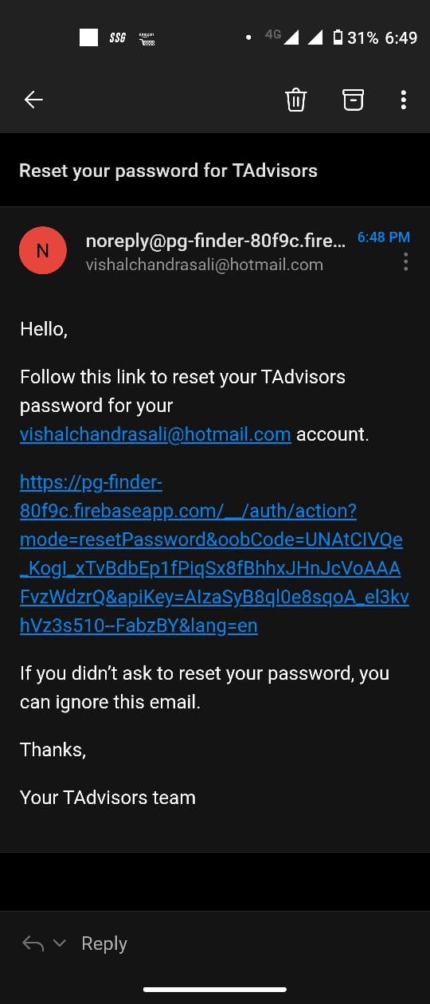
ScreenShots Login

Slide 13
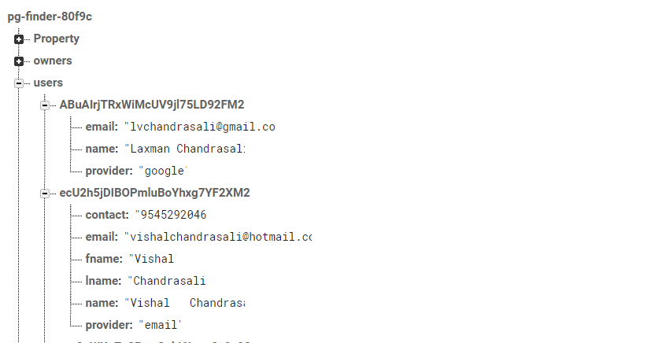
ScreenShots: DataBase

Slide 14
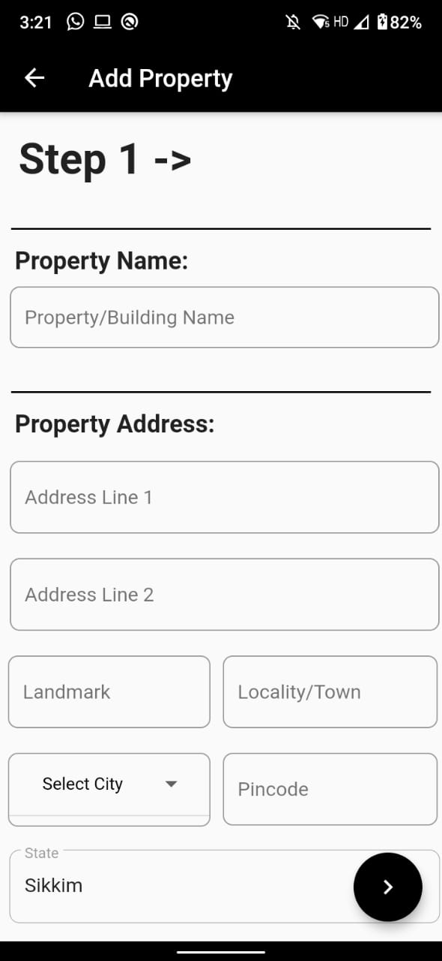
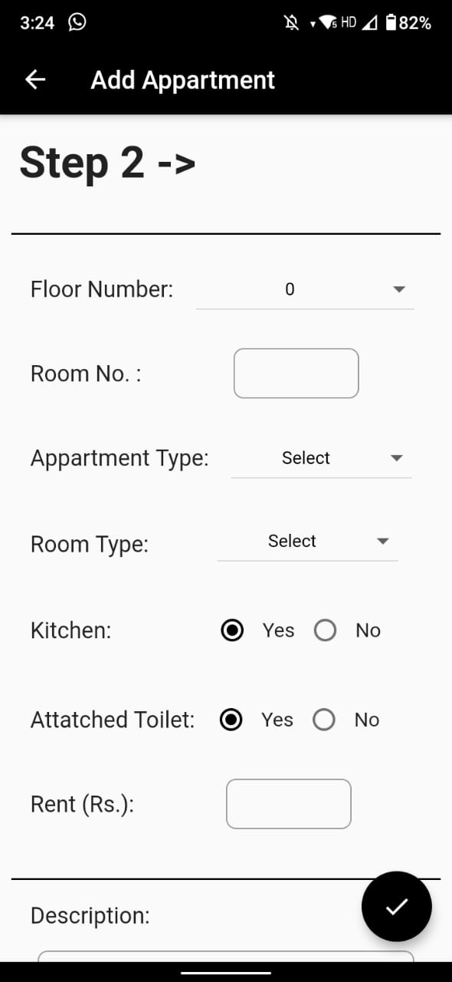
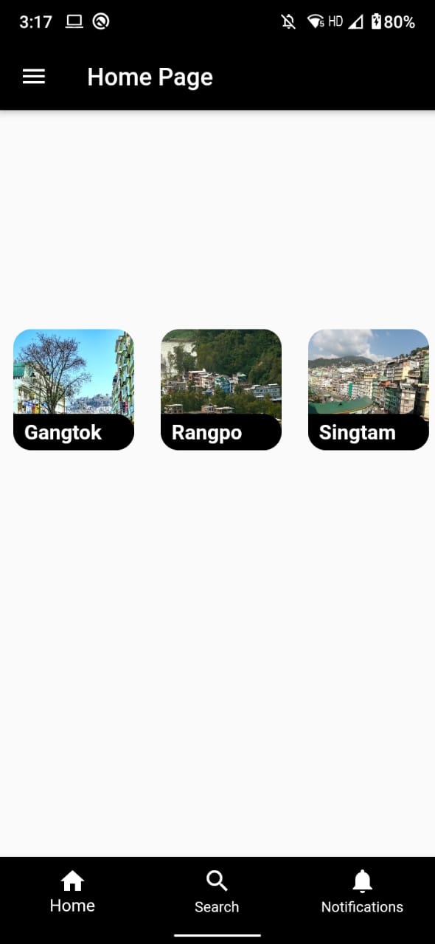
Add property & User Homepage

Slide 15
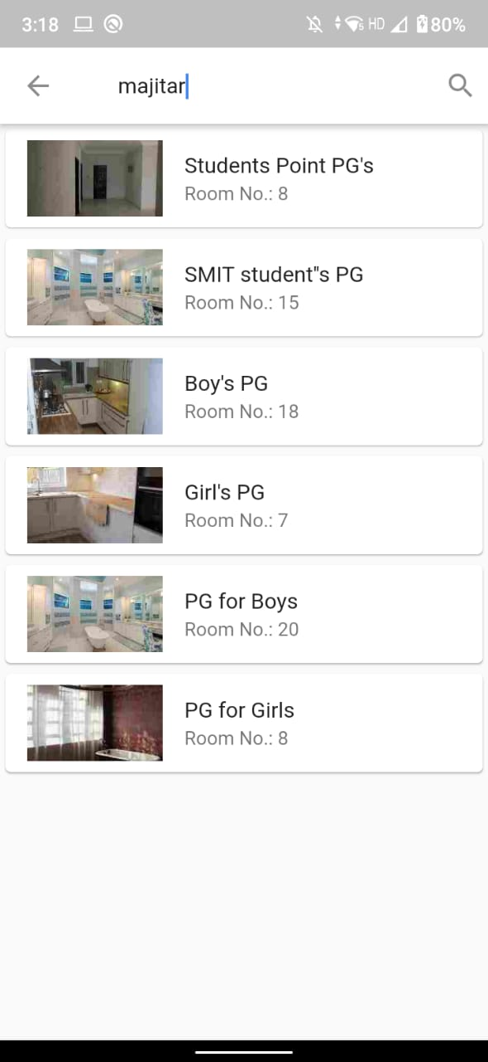
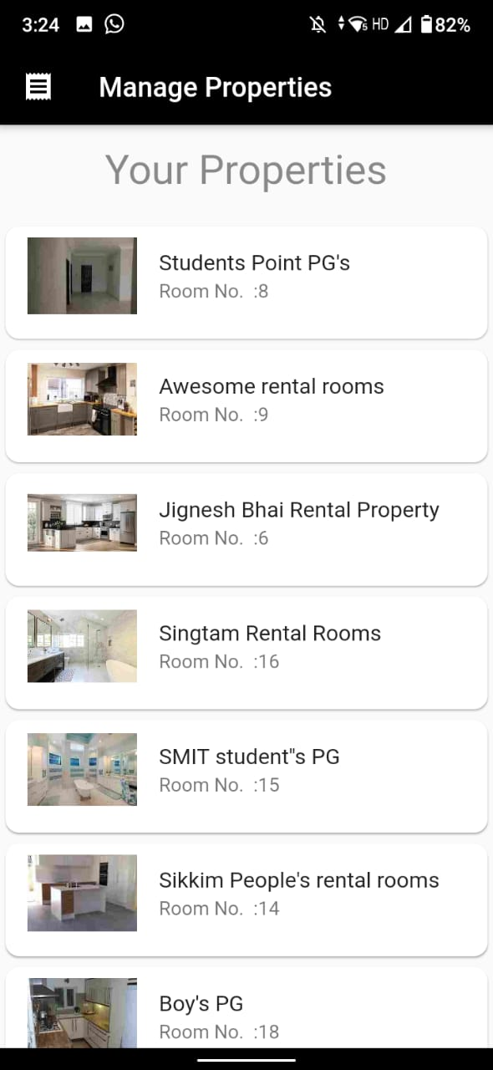
Search Module

Slide 16
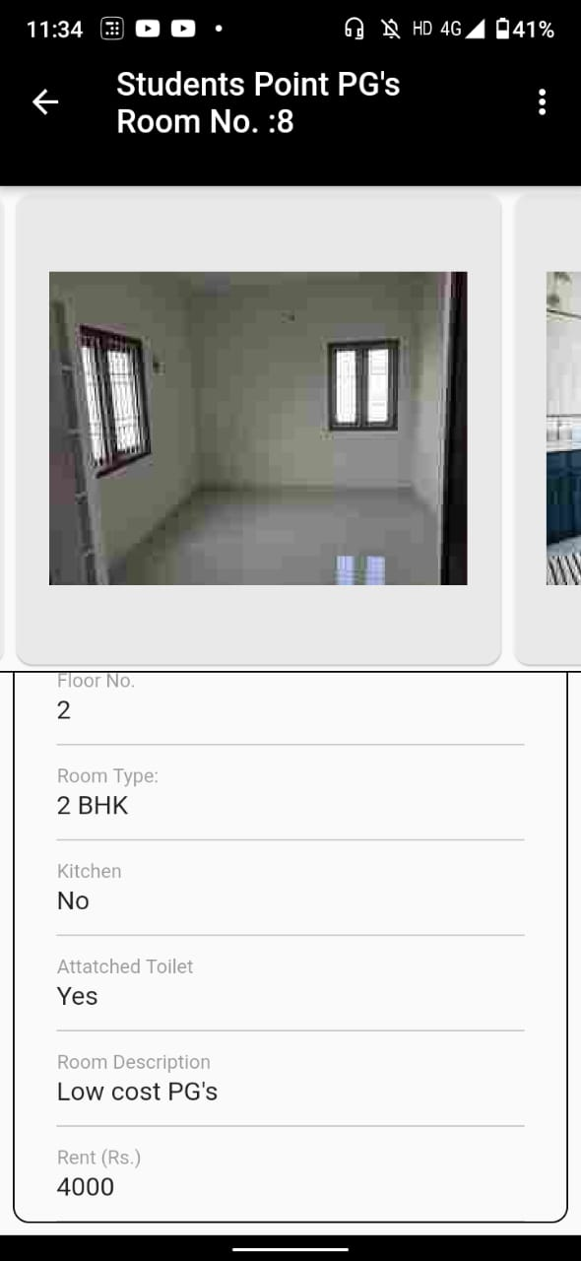
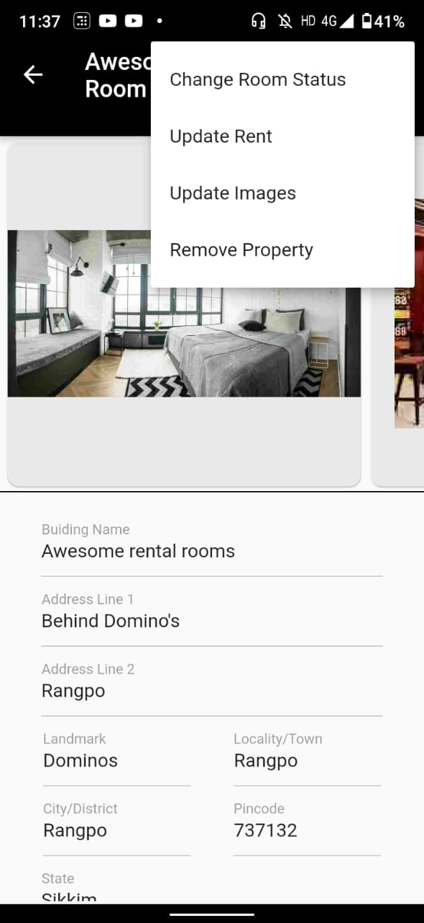
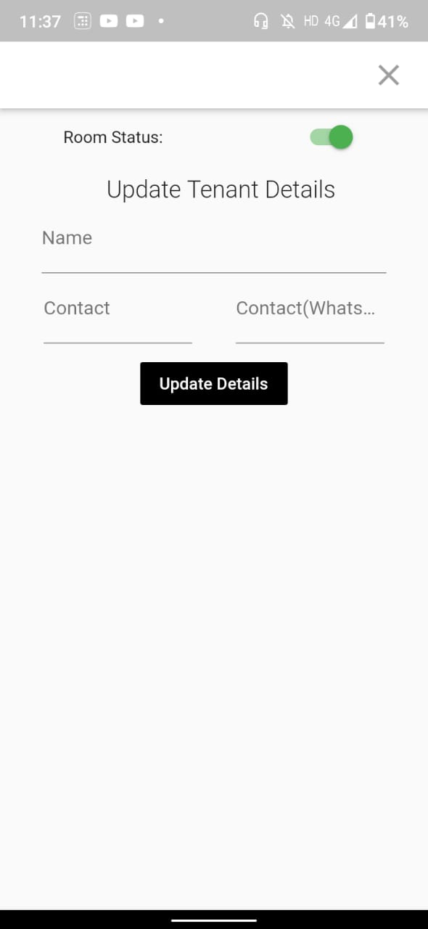
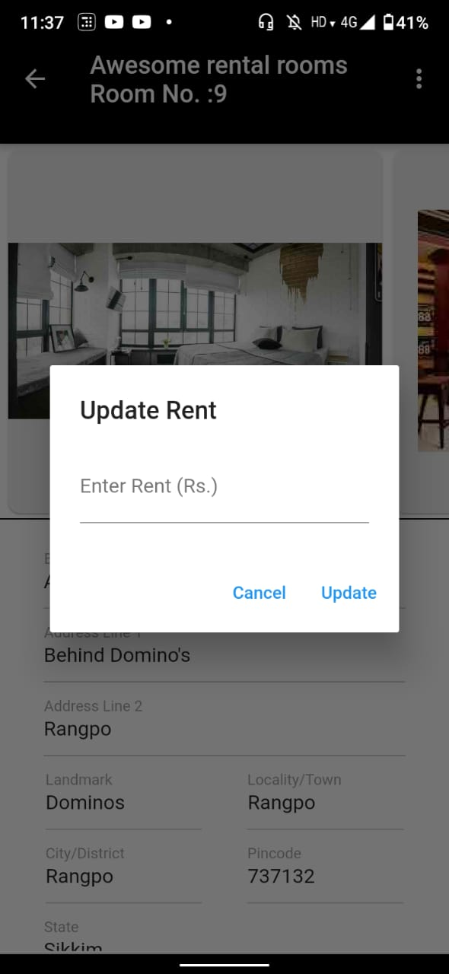
Manage property

Slide 17
Gantt Chart
Activity | Jan,20 | Feb,20 | March,20 | April,20 | May,20
Literature survey & References
Problem Identification
Design
Implementation and Testing
Report Writing

Slide 18
Thank You !

